Slide 1
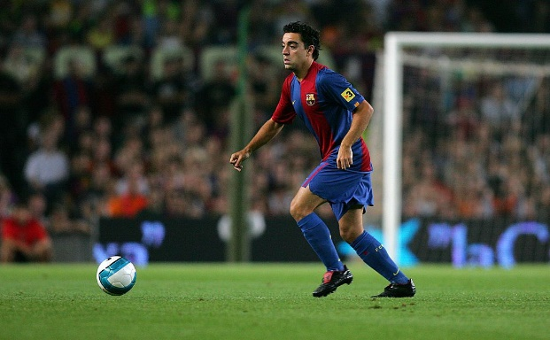



Wayne Harrison
Presents
An Exclusive eBook Series
Dropping off to Face Forward on receiving the ball.
Watch Harry Kane of Tottenham
These do not just need to be for striker (9).
We use (9) as the example player.
We Hope you enjoy this presentation.
Any questions please get in touch by email on Soccerawareness@outlook.com

Slide 2
To open the animations please do the following:
On PowerPoint press “Slideshow” then to your left on PowerPoint press “From Beginning” or “From current slide” and the animations will move.
This will work on an iPad, regular Computer and a Mac but not on your phone.
Players make two short and sharp runs to create space for themselves

Slide 3




(9) Is tracked by center back (C). (10) is on the ball to play the pass.
Animation
Too often our players receive the ball facing BACKWARDS like this.
Angle and timing of the run is vital as is the pass
Its still good but it could be better
No Mans Land
No Mans Land
Still in Control but facing backwards so cannot play forward penetrating passes.

Slide 4


(9) Is tracked by center back (C). (10) is on the ball to play the pass.
Animation
(9) BACKWARDS Pulls back and away from the defender and is now facing FORWARD with the ball to feet
Angle and timing of the run is vital as is the pass
No Mans Land
No Mans Land
Striker (9) getting free from center back (C), short And sharp movement

Slide 5

(9) Is tracked by center back (C). (10) is on the ball to play the pass.
Animation
(9) Facing BACKWARDS Pulls back and away from the defender and is now facing FORWARD with the ball to feet
Angle and timing of the run is vital as is the pass
No Mans Land
No Mans Land
Striker (9) getting free from center back (C) in a straighter drop off and FACE UP run

Slide 6



(9) Is tracked by center back (C). (10) is on the ball to play the pass.
Animation
OPPOSITE RUNS: Short, still facing BACKWARDS then off the shoulder fast, now facing FORWARD
Angle and timing of the run is vital as is the pass
No Mans Land
Zone 14
No Mans Land
Striker (9) getting free from center back (C). Harry Kane of Tottenham is great at this

Slide 7
(9) Is tracked by center back (C). (10) is on the ball to play the pass.
Animation
OPPOSITE RUNS: Checking forward to check BACK into space
If (10) on the ball is free with no pressure to pass, then they can work off the second run of (9)
Angle and timing of the run is vital as is the pass
No Mans Land
Zone 14
No Mans Land
After the first run (9) is facing BACKWARDS to the ball still. After the Check back (9) is now facing FORWARD receiving the ball.

Slide 8



(10) Is tracked by center back (E). (4) is on the ball to play the pass.
Animation
This Can happen anywhere on the field to get free and to FACE UP against an opponent
If (10) on the ball is under pressure to pass, then (4) works off the first run of (10) because (10) doesn’t have time to wait to play the pass off the second run.
No Mans Land
Angle and timing of the run is vital as is the pass
No Mans Land
Here it is center back (4) passing to number (10) dropping off into central midfield to get free and FACE UP 1 v 1; and not BACK

Slide 9



Animation
(10) Moves slightly forward; uses their body to protect the ball from Defender (E)
Angle and timing of the run is vital as is the pass
Important (7) understands the situation also
No Mans Land
No Mans Land
But is now facing backwards. Still in possession yes but it could be better for the player and their team.

Slide 10

Animation
(10) Is tight to (E) facing back and Receives and protects the ball from Defender (E)
Angle and timing of the run is vital as is the pass
Important (7) understands the situation also
Angle and timing of the run is vital as is the pass
No Mans Land
No Mans Land
(7) Doesn’t help with the angle and position of the pass. Passes to (10)’s feet so its difficult for (10) to receive and turn in such a tight area

Slide 11



Animation
(10) Is tight to (E) facing back and Receives and protects the ball from Defender (E)
Angle and timing of the run is vital as is the pass
Important (7) understands the situation also
(10) Already facing back. Ball to feet. First touch BACK into space to turn and FACE FORWARD
No Mans Land
No Mans Land
Now (10) receives the ball tight and the first touch is AWAY so it’s a two-touch movement by (10) to be able to then FACE UP

Slide 12


Animation
(10) Facing BACKWARDS Pulls back and away from defender (E) and is now facing FORWARD with the ball to feet
Angle and timing of the run is vital as is the pass
Important (7) understands the situation also
(10) Needs to get away from defender (E), therefore (7) can pass the ball a yard or more BEHIND (10) to draw that player AWAY from the defender
No Mans Land
(10) Already facing back. Ball to feet. First touch BACK into space to turn and FACE FORWARD
No Mans Land
Number (10) dropping off into central midfield to get free

Slide 13
Animation
Same idea just a different angle to drop off as perhaps that’s the best space to move to
Angle and timing of the run is vital as is the pass
Important (7) understands the situation also
No Mans Land
No Mans Land
Number (10) dropping off into central midfield to get free

